Slide 1
Programming
ELTC H1019 COMM H1021 MECH H2015
Dr. Arnulf Horn
E-mail: arnulf.horn@itb.ie
Room E108

Slide 2
Course Aims
Introduce the fundamental concepts of software development, with an emphasis on problem solving & computer programming.
Cover a structured approach to problem solving and computer programming programming in C

Slide 3
Learning Modes
Lectures will be supplemented with Practical Sessions (Computer Laboratory Exercises).
Practical Sessions to be based on contents of preceding lectures.
Attendance is a must if you aim to be successful in this module.

Slide 4
Expectations
Having successfully completed this module you should be able:
  to write basic C programs;
  to identify and use the programming constructs: simple sequence, iteration and decision;
  to design and implement software solutions to basic engineering problems;

Slide 5
Expectations
  to produce and manage a program portfolio;
  to apply the basic principles of software design.

Slide 6
Course layout
Course layout
  one lecture a week & one 3-hour practical a week
Continuous Assessments (50%) - Exam 50%

Slide 7
Continuous Assessments
Where appropriate, exercises linking to other modules covered in the course, e.g., Mathematics, Electrical Science etc will be used.
All submitted assignments and projects MUST be typewritten using a word-processor. Handwritten submissions will NOT be accepted.

Slide 8
Recommended reading
Primary Textbook :- Hanly J.R. Koffman E.B. with Horvath J.C., C Program Design for Engineers (Reprinted 1997) Addison-Wesley
Any other textbook with C programing in the title is worth checking out.

Slide 9
Introduction to C
This section is designed to give you a general overview of the C programming language.
Although much of this section will be expanded in later sections it gives you a taste of what is to come.

Slide 10
Why use C?
The largest measure of C's success seems to be based on purely practical considerations:
  the portability of the compiler;
  the standard library concept;
  a powerful and varied repertoire of operators;
  an elegant syntax;
  ready access to the hardware when needed;
  and the ease with which applications can be optimised by hand-coding isolated procedures

Slide 11
Computer languages
So what languages does the computer understand ?
Strictly speaking, the computer only understands machine language.
Using this language the programmer directly controls the hardware of the machine
but …

Slide 12
Computer languages
it is extremely difficult to use for a number of reasons.
For this reason many high-level languages were developed.
High-level programming languages, while simple compared to human languages, are more complex than the languages the computer actually understands, called machine languages. Each different type of CPU has its own unique machine language.

Slide 13
Why use C?
C is a high-level language with low-level capabilities.
C is a structured programming language.
C has gained wide-spread popularity.

Slide 14
A Brief History of C
In 1972 Dennis Ritchie at Bell Labs writes C and in 1978 the publication of The C Programming Language by Kernighan & Ritchie caused a revolution in the computing world.
In 1983, the American National Standards Institute (ANSI) established a committee to provide a modern, comprehensive definition of C. The resulting definition, the ANSI standard, or "ANSI C", was completed late 1988.

Slide 15
Uses of C
Operating Systems
Language Compilers
Assemblers
Text Editors
Print Spoolers
Network Drivers
Modern Programs
Data Bases
Language Interpreters
Utilities

Slide 16
Problem Solving
Define the Problem.
Gather Information.
Generate a Possible Solution.
Implement the Solution.
Test the Solution.

Slide 17
Define the Problem
The proper definition of the problem is essential to a good solution.
Not always easy to see the real problem.
Breakthroughs come in seeing the real problem.

Slide 18
Generate a Possible Solution
There may be many possible solutions - pick one.
Define the algorithm.
Algorithm
  a list of steps to follow to solve the problem in which order is important
  the actions to be executed, the order in which these actions are to be executed

Slide 19
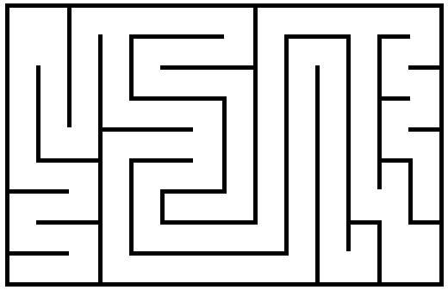
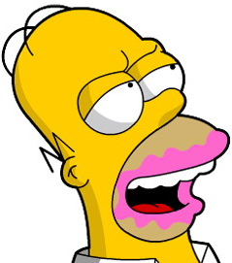
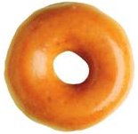
Hungry Homer Algorithm

Slide 20
Hungry Homer Algorithm

Slide 21








Semantics
The quick brown fox jumps over the lazy dog.

Slide 22
Implement the Solution
Write down the rules.
Build the machine (hardware).
OR
Write the program (software).

Slide 23
Test the Solution
Check that the solution works in many different situations.
Try different inputs.
Test with the wrong inputs.

Slide 24
Problem Definition 1
How to calculate the area of a circle?
Calculate area of circle

Slide 25
Input-Output Description
Radius
Area

Slide 26
Gather Information 1
Mathematics: a = π r²
area = π x radius x radius

Slide 27
Algorithm 1
Begin
Read radius
Calculate area = pi*radius*radius
Print area
End

Slide 28
Running C Programs
The Edit-Compile-Link-Execute Process
Developing a program in a compiled language such as C requires at least four steps:
  editing (or writing) the program
  compiling it
  linking it
  executing it
We will now cover each step separately.

Slide 29
Editing
You write a computer program with words and symbols that are understandable to human beings.
This is the editing part of the development cycle.
You type the program directly into a window on the screen and save the resulting text as a separate file.

Slide 30
Compiling
You cannot directly execute the source file.
To run on any computer system, the source file must be translated into binary numbers understandable to the computer's Central Processing Unit.
This process produces an intermediate object file - with the extension .obj, the .obj stands for Object.

Slide 31
Linking
The first question that comes to most peoples minds is Why is linking necessary? The main reason is that many compiled languages come with library routines which can be added to your program. Theses routines are written by the manufacturer of the compiler to perform a variety of tasks, from input/output to complicated mathematical functions. After linking the file extension is .exe which are executable files.

Slide 32
Executable files
Thus the text editor produces .c source files, which go to the compiler, which produces .obj object files, which go to the linker, which produces .exe executable file.
You can then run .exe files as you can other applications.

Slide 33
Generating an Executable
.lib files
.obj files
Editing
Compiling
Linking
Running
Compile time error
Linking error
Run-time error

Slide 34
Program Format
#include <stdio.h>
main()
{
}
Program specific declarations and;
statements that end with;
i.e. your program;

Slide 35
Using Microsoft C
Edit stage:
  Type program in using one of the Microsoft Windows editing packages.
Compile and link:
  Select Building from Make menu. Building option allows you to both compile and link in the same option.
Execute:
  Use the Run menu and select Go option.

Slide 36
Errors:
First error highlighted. Use Next Error from Search menu for further errors if applicable.
If you get an error message, or you find that the program doesn't work when you finally run it (at least not in the way you anticipated) you will have to go back to the source file - the .c file - to make changes and go through the whole development process again!

Slide 37
#include <stdio.h>
main()
{
int a,b,c;
a = 4;
b = 5;
c = a + b;
printf(“Program to sum t integers\n”);
printf("The sum of %d and %d is %d\n”,a,b,c);
system("PAUSE");
return 0;
}

Slide 38

Output

Slide 39
#include <stdio.h>
main()
{
double radius, area, circum;
printf("Enter radius> ");
scanf("%lf", &radius);
area = 3.14 * radius * radius;
circum = 2 * 3.14 * radius;
printf("The area is %.2f\n", area);
printf("The circumference is %.2f\n", circum);
system("PAUSE");
return 0;
}

Slide 40
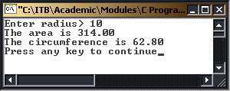
Output

Slide 41
Structure of C Programs

Slide 42
C's Character Set
The only characters required by the C Programming Language are as follows:
  A - Z
  a -z
  0 - 9
  space . , : ; ' $ "
  # % & ! _ {} [] () < > |
  + - / * =

Slide 43
The form of a C Program
All C programs will consist of at least one function, but it is usual (when your experience grows) to write a C program that comprises several functions.
The only function that has to be present is the function called main. For more advanced programs the main function will act as a controlling function calling other functions in their turn to do the dirty work!

Slide 44
The form of a C Program
C makes use of only 32 keywords which combine with the formal syntax to the form the C programming language. Note that all keywords are written in lower case - C, like UNIX, uses upper and lowercase text to mean different things.
If you are not sure what to use then always use lowercase text in writing your C programs. A keyword may not be used for any other purposes.

Slide 45
The form of a C Program
Keywords:
auto double int structbreak else long switchcase enum register typedefchar extern return unionconst float short unsignedcontinue for signed voiddefault goto sizeof volatiledo if static while

Slide 46
Your First Program
Now that you've seen the compiler in action it's time for you to write your very own first C program. You can probably guess what it's going to be - the program that everyone writes just to check they understand the very basics of what is going on in a new language.
All your first program is going to do is print the message "Hello World" on the screen.

Slide 47
Your First Program
The program is a short one, to say the least. Here it is:
/*L2_1.c*/
#include <stdio.h>
main()
{
printf("Hello World\n");
printf("line 1\nline 2\nline 3\n“);
system("PAUSE");
return 0;
}

Slide 48
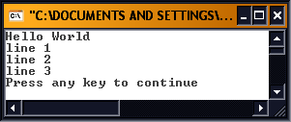
Output

Slide 49
Your First Program
#include <stdio.h>
So all our C programs will need at least one of C's standard libraries which deals with standard inputting and outputting of data.
This library is called stdin.h and it is declared in our programs before the main function. The .h extension indicates that this is a header file.

Slide 50
Your First Program
The first line is the standard start for all C programs - main()
After this comes the program's only instruction enclosed in curly brackets {} The curly brackets mark the start and end of the list of instructions.
Notice the semicolon marking the end of the instruction.

Slide 51
Your First Program
If you're puzzled about why the curly brackets are on separate lines I'd better tell you that it's just a layout convention to help you spot matching brackets. C is very unfussy about the way you lay it out. For example, you could enter the Hello World program as:
main(){printf("Hello World\n");}

Slide 52
Your First Program
The printf function does what its name suggest it does: it prints, on the screen, whatever you tell it to. The "\n" is a special symbols that forces a new line on the screen.

Slide 53
Add Comments to a Program
A comment is a note to yourself (or others) that you put into your source code.
All comments are ignored by the compiler. They exist solely for your benefit. Comments are used primarily to document the meaning and purpose of your source code, so that you can remember later how it functions and how to use it. You can also use a comment to temporarily remove a line of code. Simply surround the line(s) with the comment symbols.

Slide 54
Add Comments to a Program
In C, the start of a comment is signalled by the /* character pair. A comment is ended by */. For example, this is a syntactically correct C comment:
/* This is a comment. */
Comments can extend over several lines and can go anywhere except in the middle of any C keyword, function name or variable name. In C you can't have one comment within another comment. That is comments may not be nested.

Slide 55
Add Comments to a Program
Lets now look at our first program one last time but this time with comments:
Note: from now on the two lines “system("PAUSE");” and “return 0;” have been ommitted from code for clarity. You should know that they are required if used within DevC compiler for console applications.
*/L1_2.c*/
#include<stdio.h>
main() /* main function heading */
{
printf("\n Hello, World! \n");
/* Display message on */
} /* the screen */

Slide 56
Data Types
There are four basic data types associated with variables:
  int - integer: a whole number.
  float - floating point value: ie a number with a fractional part.
  double - a double-precision floating point value.
  char - a single character
  Note: all C's variables must begin with a letter or a "_" (underscore) character

Slide 57
Integer Number Variables
An int variable can store a value in the range -32768 to +32767. You can think of it as a largish positive or negative whole number.
To declare an int you use the instruction:
int variable name;
For example: int a; declares that you want to create an int variable called a. To assign a value to our integer variable we would use the following C statement
a=10;

Slide 58
Floating Point
float
  floating point numbers in the range:
  ±3.40282 10^{±38}
  6 digits of precision.
    ±3.40282 e±38, ±3.40282 E±38

Slide 59
Double Floating Point
double
  uses twice as much storage as float.
  floating point numbers in the range:
  ±1.797693 10^{±308}
  15 digits of precision.
  double distance;

Slide 60
Decimal Number Variables
float total;
double sum;
To assign a numerical value to our floating point and double precision variables we would use the following C statement:
total=1.0;
sum=12.50;

Slide 61
Character Variables
C only has a concept of numbers and characters.
To declare a variable of type character we use the keyword char. - A single character stored in one byte – i.e.
char c;
To assign, or store, a character value in a char data type is easy - a character variable is just a symbol enclosed by single quotes – i.e.
c='A'

Slide 62
Assignment Statement
Once you've declared a variable you can use it, attempts to use a variable that has not been defined will cause a compiler error. Using a variable means storing something in it.
name = value;
For example:
a=10;
stores the value 10 in the int variable a. What could be simpler? Not much, but it isn't actually very useful!

Slide 63
Assignment Statement
Consider four very simple mathematical operations: add, subtract, multiply and divide. Let us see how C would use these operations on two float variables a = 10 and b = 3
Answer
add : a+b 13
subtract : a-b 7
multiply : a*b 30
divide : a/b 3.33
modulus : a%b 1

Slide 64
Assignment Statement
BE CAREFUL WITH ARITHMETIC!!! What is the answer to this simple calculation?
a=10/3
The answer depends upon how a was declared. If it was declared as type int the answer will be 3; if a is of type float then the answer will be 3.333.

Slide 65
Assignment Statement
Two points to note from the above calculation:
  C ignores fractions when doing integer division!
  When doing float calculations integers will be converted into float. We will see later how C handles type conversions.

Slide 66
Arithmetic Ordering
Consider the following calculation:
a=10.0 + 2.0 * 5.0 - 6.0 / 2.0
What is the answer? 27 or 17??
In the above calculation the multiplication and division parts will be evaluated first and then the addition and subtraction parts. This gives an answer of 17.
Note: To avoid confusion use brackets. The following are two different calculations:
a=10.0 + (2.0 * 5.0) - (6.0 / 2.0)
a=(10.0 + 2.0) * (5.0 - 6.0) / 2.0

Slide 67
Arithmetic Ordering
() Brackets
++ Increment
-- Decrements
* Multiplication
/ Division
+ Addition
- Subtraction
% Modulus
= Assignment

Slide 68
Arithmetic Ordering
You can freely mix int, float and double variables in expressions. In nearly all cases the lower precision values are converted to the highest precision values used in the expression.
For example, the expression f*i, where f is a float and i is an int, is evaluated by converting the int to a float and then multiplying. The final result is, of course, a float but this may be assigned to another data type and the conversion will be made automatically.

Slide 69
Arithmetic Ordering
This is very reasonable but more surprising is the fact that the data type char can also be freely mixed with ints, floats and doubles.
A character is represented as an ASCII or some other code in the range O to 255, and if you want you can use this integer code value in arithmetic.
Another way of thinking about this is that a char variable is just a single-byte integer variable that can hold a number in the range O to 255, which can optionally be interpreted as a character.

Slide 70
Something To Declare
Before you can use a variable you have to declare it.
You can declare any number of variables of the same type with a single statement. For example:
int a, b, c;
declares three integers: a,b and c. You have to declare all the variables that you want to use at the start of the program.
Here is an example program that includes some of the concepts outlined today.

Slide 71
/*******************************************
Another simple program using int and printf
*******************************************/
#include <stdio.h>
main()
{
int a,b,average;
a=10;
b=6;
average = ( a+b ) / 2;
printf("Here “);
printf("is ");
printf("the ");
printf("answer... ");
printf("\n");
printf("%d.",average);
system("PAUSE");
return 0;
}

Slide 72
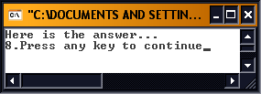
Output

Slide 73
More On Initialising Variables
You can assign an initial value to a variable when you declare it:
int i=1;
sets the int variable to one as soon as it's created. This is just the same as:
int i;
i=l;
Don't assume that an uninitialised variable has a sensible value stored in it. Some C compilers store 0 in newly created numeric variables but nothing in the C language compels them to do so.

Slide 74
Input and Output Functions

Slide 75
printf Function
Syntax:printf(“format-string”,arg1,arg2,..):
format-string: a string constant or a string containing format information.
The format information depends on the type of value to be output.
The following table lists the format identifiers:

Slide 76
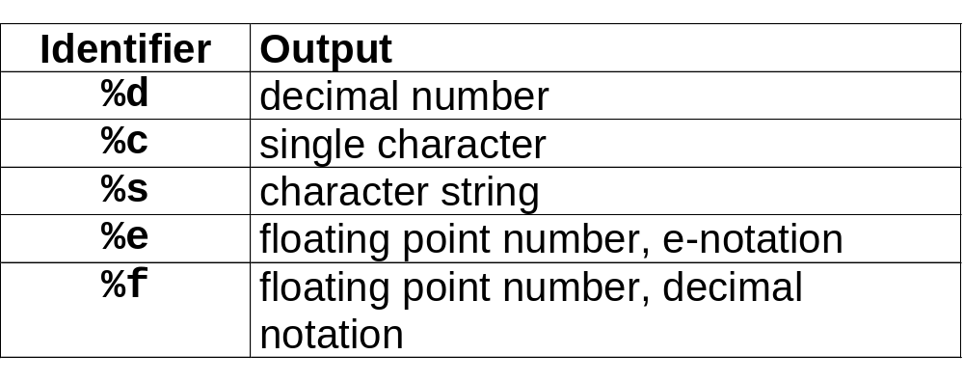
printf Function

Slide 77
printf Function
printf("\n");
Translation: set cursor to start of next line ( called a carriage return and line feed).
Examples of “printf” statements:
Statement:
printf("hello world ");
printf("I feel wonderful today");
printf("%d", 2);
printf("%d", 4*5);
printf("2+3*4 = %d", 2+3*4);
Output:
hello world
I feel wonderful today
2
20
2+3*4=14

Slide 78
scanf Function
Syntax: scanf(“format_identifier”, var1,var2,..);
format_identifier : similar to those used for printf ie.%d, &f, %c etc
var1,var2, ..: declared variable list.
scanf("%d", &x);
scanf("%d %d", &x,&y);
Note: the variable name must be preceded with the ‘&’ sign

Slide 79
scanf Function
Translation: Read values from the input buffer and associate them with the corresponding variables in the variable list.
scanf("%d %d",&i,&j);
will read in two integer values into i and j.
The integer values can be typed on the same line or on different lines as long as there is at least one white space character between them.

Slide 80
Example
/***************************************
Program accepts two values and sums them
***************************************/
#include <stdio.h>
main()
{
int a,b,c;
printf("\nThe first number is ");
scanf("%d",&a);
printf("The second number is ");
scanf("%d",&b);
c=a+b;
printf("The answer is %d \n",c);
system("PAUSE");
return 0;
}

Slide 81
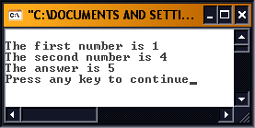
Output

Slide 82
Explanation
The first instruction declares three integer variables: a,b and c.
The first two printf statements simply display message on the screen asking the user for the values.
The scanf functions then read in the values from the keyboard into a and b. These are added together and the result in c is displayed on the screen with a suitable message.
Notice the way that you can include a message in the printf statement along with the value.

Slide 83
/**************************************
Combined scanf this time
**************************************/
#include<stdio.h>
main()
{
int a,b,c;
printf("\nEnter Two Numbers ");
scanf("%d%d",&a, &b);
c=a+b;
printf("The answer is %d \n",c);
system("PAUSE");
return 0;
}

Slide 84
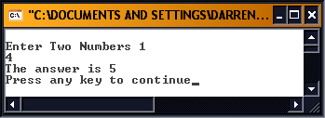
Output

Slide 85
/****************************
some printf variations
****************************/
#include<stdio.h>
main()
{
float number;
number = 3.123456;
printf("%.1f\n", number);
printf("%.2f\n", number);
printf("%.3f\n", number);
printf("%.4f\n", number);
printf("%.5f\n", number);
printf("%.6f\n", number);
printf("%10.6f\n", number);
system("PAUSE");
return 0;
}

Slide 86
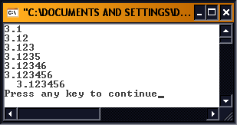
Output

Slide 87
Promotion Hierachy for Data Types
Data Type | printf conversion specifier | scanf conversion specifier
double | %d | %ld
float | %f | %f
int | %d | %d
char | %c | %c

Slide 88
Control Loops

Slide 89
Go with the flow
Suppose we ask you to display "Hello World!" five times on the screen. Easy! you'd say:
#include <stdio.h>
main()
{
printf("Hello World!\n");
printf("Hello World!\n");
printf("Hello World!\n");
printf("Hello World!\n");
printf("Hello World!\n");
system("PAUSE");
return 0;
}

Slide 90
Go with the flow
But now we up the bet and ask you to do the same job for 100 hellos or, if you're still willing to type that much code, maybe 1,000 Hello World's, 10,000 Hello World's, or whatever it takes you to realize this isn't a sensible method!
The solution to this problem is the while loop or the do while loop.

Slide 91
The while and do while Loops
You can repeat any statement using either the while loop or the do while loop :
while(condition){compound statement;}
The condition is just a test to control how long you want the compound statement to carry on repeating.

Slide 92
The while loops
product <= 1000
true
product = 2 * product
false

Slide 93
The do while Loop
The do while loop :
do{compound statement;} while(condition);
The condition is just a test to control how long you want the compound statement to carry on repeating.

Slide 94
The do while Loop
Action(s)
true
condition
false

Slide 95
The while and do while Loops
The braces { } delimits the compound statement.
If the condition is true the statement is obeyed one more time.
If the condition turns out to be false, the looping isn't obeyed and the program moves on to the next statement.

Slide 96
The while and do while Loops
The do while loop will always execute the code within the loop at least once, since the condition controlling the loop is tested at the bottom of the loop.
The do while loop repeats the instruction while the condition is true.

Slide 97
Conditions or Logical Expressions
The only detail we need to clear up is what the condition (or Logical Expression) can be. The condition can be any test of one value against another. For example:
a>0
is true if a contains a value greater than zero;
The only complication is that the test for 'something equals something else' uses the character sequence ‘==‘ and not ‘=‘

Slide 98
Conditions or Logical Expressions
/******************************
Infinite while loop
******************************/
#include <stdio.h>
main()
{
while (1 == 1)
{
printf("Hello World!\n");
}
}

Slide 99
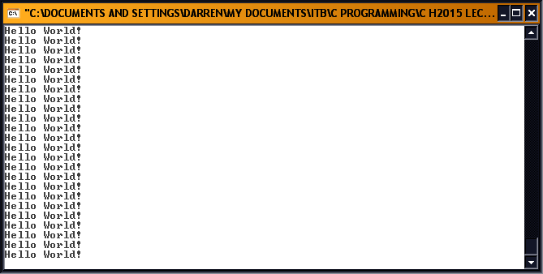
Output

Slide 100
/******************************
Infinite while loop
******************************/
#include <stdio.h>
main()
{
while (1 == 2)
{
printf("Hello World!\n");
}
}

Slide 101
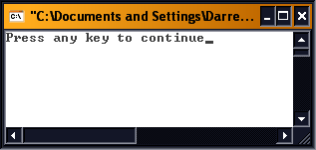
Output

Slide 102
/******************************
Infinite do while loop
******************************/
#include <stdio.h>
main()
{
do
{
printf("Hello World!\n");
}
while (1 == 1);
}

Slide 103
Output

Slide 104
/******************************
Infinite do while loop
******************************/
#include <stdio.h>
main()
{
do
{
printf("Hello World!\n");
}
while (1 == 2);//note condition
}

Slide 105
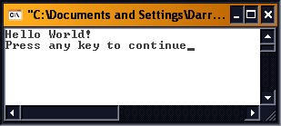
Output

Slide 106
Conditions or Logical Expressions
If you type either of these programs in and run it you will find that your screen fills with a never ending list of "Hello World!"s. Why? Because the condition to keep the repeat going is (1==1),
You can stop an infinite loop by pressing Ctrl-Break or Ctrl-C.
To solve our problem of printing 100 "Hello World!"s we need a counter and a test for when that counter reaches 100 ‘a=a+1;’

Slide 107
Conditions or Logical Expressions
a=a+1;
a++;
This always confuses beginners, because they aren't used to seeing the variable on both sides of the equal-sign.
All this means is that a has one added to it to produce a new value, and this value is stored back in the location.

Slide 108
/************************************
Hello World 100 times - while
*******************************/
#include <stdio.h>
main()
{
int count;
count=0;
while (count < 100)
{
count++;
printf("Hello World!\n");
}
}

Slide 109
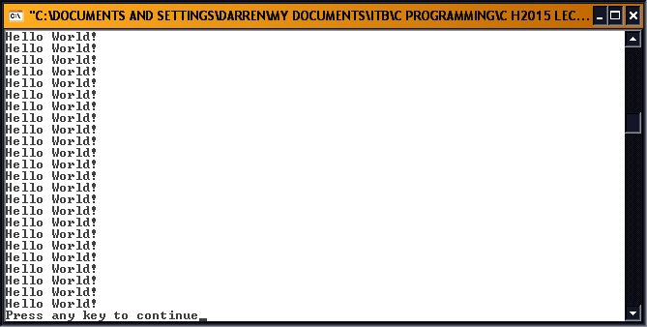
Output

Slide 110
/************************************
Hello World 100 times – do while
*******************************/
#include <stdio.h>
main()
{
int count;
count=0;
do
{
count++;
printf("Hello, World!\n");
}
while (count < 100);
}

Slide 111
Conditions or Logical Expressions
Note: the use of the { and } to form a compound statement; all statements between the braces will be executed before the loop check is made.

Slide 112
Looping the Loop
We have seen that any list of statements enclosed in curly brackets is treated as a single statement, a compound statement.
while (condition)
{
statementl;
statement2;
statement3;
}

Slide 113
The for Loop
The while, and do-while, loop is a completely general way of repeating a section of program over and over again - and you don't really need anything else.
The traditional solution to this problem is to introduce a variable that is used to count the number of times that a loop has been repeated and use its value in the condition to end the loop.

Slide 114
The for Loop
i=l;
while (i<10)
{
printf("%d \n",i);
i++;
}
The question is how many times does the loop go round? More specifically what values of i is the loop carried out for?

Slide 115
The for Loop
In C, the for loop gives more control.
for(counter=0;counter<=100; counter++){
compound statement;
}

Slide 116
The for Loop
i = 1
true
i<=100
printf("%d \n",i);
i++
false

Slide 117
The for Loop
For example to print the numbers 1 to 100 you could use:
for( i=l; i <= 100; i++ ){
printf("%d \n",i);
}
You can, of course repeat a longer list of instructions simply by using a compound statement.

Slide 118
The for Loop
Consider the following program, it does a temperature conversion, but it also introduces one or two new concepts:
Our counter does not have to be incremented (decremented) by 1; we can use any value.
We can do calculations within the printf statement.

Slide 119
/*****************************************
Temperature conversion using a for loop
*****************************************/
#include <stdio.h>
main()
{
int fahr;
for ( fahr=0 ; fahr<=50 ; fahr++)
{
printf("%d %.1f\n", fahr,(5.0/9.0)*(fahr-32));
}
}

Slide 120
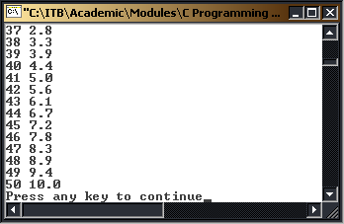
Output

Slide 121
#include <stdio.h>
main()
{
int lower , upper , step;
float fahr , celsius;
lower = 0 ;
upper = 50;
step = 20 ;
fahr = lower;
while ( fahr <= upper )
{
celsius = (5.0 / 9.0) * (fahr - 32.0);
printf("%.2f %.2f\n",fahr, celsius);
fahr++;
}
}

Slide 122
Conditional Execution

Slide 123
Program Control
It is time to turn our attention to a different problem - conditional execution. We often need to be able to choose which set of instructions are obeyed according to a condition.
For example, if you're keeping a total and you need to display the message 'OK' if the value is greater than zero:
if (total>O){
printf("OK");
}

Slide 124
Program Control
The if statement allows you to evaluate a > condition and only carry out the statement, or compound statement, that follows if the condition is true.
In other words the printf will only be obeyed if the condition total > 0 is true.
if(condition){
statement;
}

Slide 125
#include <stdio.h>
main()
{
int a , b;
do
{
printf("\nEnter first number: ");
scanf("%d",&a);
printf("\nEnter second number: ");
scanf("%d",&b);
if(a<b)
{
printf("\n\nFirst number is less than second\n\n");
}
if(b<a)
{
printf("Second number is less than first\n\n");
}
} while (a < 999);
}

Slide 126
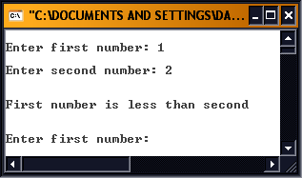
Output

Slide 127
#include <stdio.h>
main()
{
int a , b;
do
{
printf("\nEnter first number: ");
scanf("%d" , &a);
printf("\nEnter second number: ");
scanf("%d" , &b);
if (a<b)
{
printf("\n\nFirst number is less than second\n");
printf("Their difference is : %d\n" , b-a);
printf("\n");
}
printf("\n");
} while (a < 999);
}

Slide 128
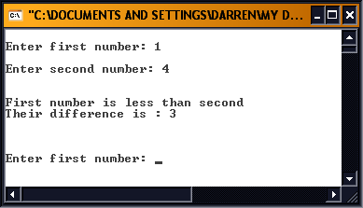
Output

Slide 129
Program Control
Another possibility is that you might want to select one of two possible statements - one to be obeyed when the condition is true and one to be obeyed when the condition is false. You can do this using the:
if (condition) {statement1;}
else {statement2;}
form of the if statement.

Slide 130
Program Control
In this case statement1 is carried out if the condition is true and statement2 if the condition is false.
Notice that it is certain that one of the two statements will be obeyed because the condition has to be either true or false!

Slide 131
Logical Expressions
> | (greater than)
< | (less than)
>= | (for greater than or equal to )
<= | (for less than or equal to)
== && || | (to test for equality) (logical AND) (logical OR)

Slide 132
Logical Expressions
This causes beginners lots of problems because they tend to write: if (a = 10) instead of if (a == 10)
The situation is made worse by the fact that the statement if (a = 10) is legal and causes no compiler error messages!
It may even appear to work at first because, due to a logical quirk of C, the assignment actually evaluates to being true.

Slide 133
Logical Expressions
Just as the equals condition is written differently from what you might expect so the non-equals sign looks a little odd. You write not equals as !=. For example:
if (a != 0)
is 'if a is not equal to zero'.

Slide 134
#include <stdio.h>
main ()
{
int num1, num2;
printf("\nEnter first number ");
scanf("%d",&num1);
printf("\nEnter second number ");
scanf("%d",&num2);
if(num2 ==0)
{
printf("\n\nCannot devide by zero\n\n");
}
else
{
printf("\n\nAnswer is %d\n\n",num1/num2);
}
}

Slide 135
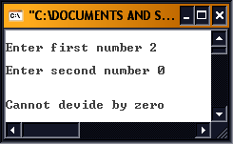
Output 1

Slide 136
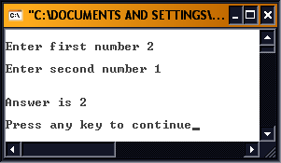
Output 2

Slide 137
#include <stdio.h>
main ()
{
int num1, num2;
printf("\nEnter first number ");
scanf("%d",&num1);
printf("\nEnter second number ");
scanf("%d",&num2);
if(num1 > 10 && num2 >10)
{
printf("\n\nBoth numbers are greater than 10\n\n");
}
if(num1 > 10 || num2 > 10)
{
printf("\n\nAt least one number is > 10\n\n");
}
}

Slide 138
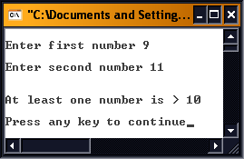
Output 1

Slide 139
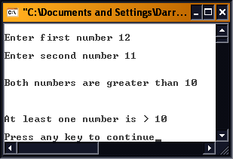
Output 2

Slide 140
Using break and continue Within Loops
The break statement allows you to exit a loop from any point within its body, bypassing its normal termination expression.
When the break statement is encountered inside a loop, the loop is immediately terminated, and program control resumes at the next statement following the loop.

Slide 141
True and False in C
The continue statement is somewhat the opposite of the break statement.
It forces the next iteration of the loop to take place, skipping any code in between itself and the test condition of the loop.

Slide 142
True and False in C
In while and do-while loops, a continue statement will cause control to go directly to the test condition and then continue the looping process
In the case of the for loop, the increment part of the loop continues.

Slide 143
#include <stdio.h>
main()
{
int x ;
for ( x=0 ; x<=100 ; x++) {
if (x%2){
continue;
}
printf("%d\n" , x);
}
}

Slide 144
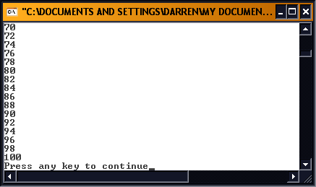
Output

Slide 145
Select Paths with switch
While if is good for choosing between two alternatives, it quickly becomes cumbersome.
The switch statement is C's multiple selection statement. It is used to select one of several alternative paths in program execution and works like this: A variable is successively tested against a list of integer or character constants. When a match is found, the statement sequence associated with the match is executed.

Slide 146
Select Paths with switch
switch(expression)
{
case constant1: statement sequence; break;
case constant2: statement sequence; break;
case constant3: statement sequence; break;
.
.
.
default: statement sequence; break;
}

Slide 147
Select Paths with switch
The default statement sequence is performed if no matches are found.
The default is optional and if all matches fail and default is absent, no action takes place.
When a match is found, the statement sequence associated with that case are executed until break is encountered

Slide 148
#include <stdio.h>
main()
{
int i;
printf("Enter a number between 1 and 4");
scanf("%d",&i);
switch (i)
{
case 1:
printf("one\n");
break;
case 2:
printf("two\n");
break;
case 3:
printf("three\n");
break;
case 4:
printf("four\n");
break;
default:
printf("unrecognized number\n");
} /* end of switch */
}

Slide 149
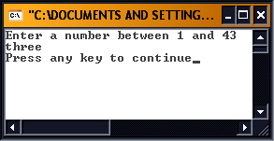
Output 1

Slide 150
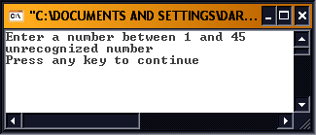
Output 2

Slide 151
Select Paths with switch
This simple program recognizes the numbers 1 to 4 and prints the name of the one you enter.
The switch statement differs from if, in that switch can only test for equality, whereas the if conditional expression can be of any type.
Also switch will work with only int and char types.

Slide 152
Math Library Functions
Perform common mathematical calculations
  #include <math.h>
If multiple arguments, use comma-separated list
  printf( "%.2f", sqrt( 900.0 ) );
Calls function sqrt, which returns the square root of its argument
All math functions return data type double
  Arguments may be constants, variables, or expression.

Slide 153
Math Library Functions
Common math.h library functions:
sqrt(x) square root of x sqrt(900.0) = 30.00
exp(x) exponential function ex exp(1) = 2.718282
log (x) natural log of x (base e) log(2.718282) = 1.0
pow(x,y) x raised to the power of y pow(2,7) = 128.0
fmod(x,y) remainder of x/y as a float fmod(13.657,2.333)=1.992
sin(x) trigonomrtric sine of x sin(0.0) = 0.0
cos(x) trigonomrtric cosine of x cos(0.0) = 1.0
tan(x) trigonomrtric tangent of x tan(0.0) = 0.0

Slide 154
Example
Length of a line on a graph:
y
x₂, y₂
Length
x₁, y₁
√{(x₂-x₁)²+(y₂-y₁)²}
x

Slide 155
Program for Length of Line
#include <stdio.h>
#include <math.h>
main()
{
float dx, dy, length;
float x1=1.0, x2=10.0, y1=5.0, y2=20.0;
dx=x2-x1; dy=y2-y1;
length=sqrt(pow(dx,2.0)+pow(dy,2.0));
printf("Length is %.2f\n", length);
}

Slide 156

Output

Slide 157
Data Types ll and Arrays

Slide 158
Data Types ll
So far we have looked at local variable now we switch our attention to other types of variables supported by the C programming language:
Global Variables
Constant Data Types

Slide 159
Global variables
Variables can be declared as either local variables which can be used inside the function it has been declared in (more on this in further sections) and global variables which are known throughout the entire program.
Global variables are created by declaring them outside any function. For example:

Slide 160
Global variables
#include<sdtio.h>
int max; //Global variable
main()
{
.....
}

Slide 161
Global variables
The int max can be used in both main and any other function and any changes made to it will remain consistent for both functions.
The understanding of this will become clearer when you have studied the section on functions.

Slide 162
#include <stdio.h>
float tax = 0.05; //Note ‘;’
main()
{
float amount,taxes,total;
printf("Enter the amount purchased : ");
scanf("%f",&amount);
taxes = tax*amount;
total = taxes+amount;
printf("The sales tax is %.2f",taxes);
printf("\n The total bill is %.2f\n",total);
tax = 0.10;
printf("\nGlobal variable tax = %.2f\n",tax);
}

Slide 163
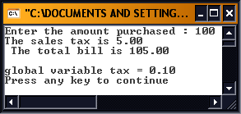
Output

Slide 164
Constant Data Types
Constants refer to fixed values that may not be altered by the program. All the data types we have previously covered can be defined as constant data types if we so wish to do so. The constant data types must be defined before the main function. The format is as follows:
#define CONSTANTNAME value

Slide 165
Constant Data Types
#define SALESTAX 0.05
The constant name is normally written in capitals and does not have a semi-colon at the end.
The use of constants is mainly for making your programs easier to be understood and modified by others and yourself in the future.

Slide 166
#include <stdio.h>
#define SALESTAX 0.05
main()
{
float amount,taxes,total;
printf("Enter the amount purchased : ");
scanf("%f",&amount);
taxes = SALESTAX*amount;
total = taxes+amount;
printf("The sales tax is %.2f",taxes);
printf("\n The total bill is %.2f\n",total);
}

Slide 167
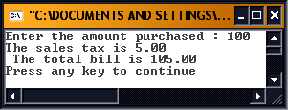
Output

Slide 168
Constant Data Types
The float constant SALESTAX is defined with value 0.05.
If the value of SALESTAX alters in the future it is very easy to change the value where it is defined rather than go through the whole program changing the individual values separately, which would be very time consuming in a large program with several references.

Slide 169
Arrays

Slide 170
Arrays
There are times when we need to store a complete list of numbers or other data items.
You could do this by creating as many individual variables as would be needed for the job, but this is a hard and tedious process.

Slide 171
#include<stdio.h>
main()
{
int a1,a2,a3,a4,a5;
scanf("%d %d %d %d %d",&a1,&a2,&a3,&a4,&a5);
printf("\n%d %d %d %d %d\n",a5,a4,a3,a2,a1);
}

Slide 172
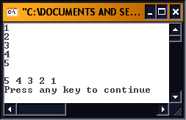
Output

Slide 173
Arrays
Doesn't look very pretty does it, and what if the problem was to read in 100 or more values and print them in reverse order?
Arrays make this easier.
In the case of C you have to declare an array before you use it - in the same way you have to declare any sort of variable. For example,
int a[5];
declares an array called a with five elements.

Slide 174
Arrays
Just to confuse matters a little the first element is a[0] and the last a[4].
C programmer's always start counting at zero!
In C you have to remember that:
type array[size]
declares an array of the specified type and with size elements. The first array element is array[0] and the last is array[size-1].

Slide 175
Element Locations
Name of array (Note that all elements of this array have the same name, c)
c[0]
-45
c[1]
6
c[2]
0
c[3]
72
This array has twelve elements of type int. Any one of these elements can be accessed by using the array name and location number.
c[4]
1543
c[5]
-89
c[6]
0
c[7]
62
c[8]
-3
c[9]
1
Position number of the element within array c (subscript)
c[10]
6453
c[11]
78

Slide 176
#include <stdio.h>
main()
{
int a[5];
int i;
for(i =0; i < 5; i++){
scanf("%d",&a[i]);
}
for(i =4;i>=0; i--){
printf("%d",a[i]);
}
printf(“\n”);
}

Slide 177
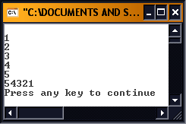
Output

Slide 178
Arrays
The for loop and the array data type were more or less made for each other. The for loop can be used to generate a sequence of values to pick out and process each element in an array in turn. Once you start using arrays, for loops like:
for (i=0 ; i<5 ; i++)
to generate values in the order 0,1,2 and so forth, and

Slide 179
In Dis-array
An array of character variables is in no way different from an array of numeric variables, but programmers often like to think about them in a different way.
For example, if you want to read in and reverse five characters you could use:

Slide 180
#include<stdio.h>
main()
{
char a[5];
int i;
for(i=0; i<5; i++){
scanf("%c",&a[i]);
}
for(i=4;i>=0;i--){
printf("%c",a[i]);
}
printf("\n");
}

Slide 181
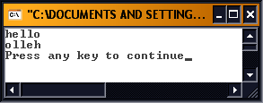
Output

Slide 182
Arrays
Notice that the only difference, is the declared type of the array and the %c used to specify that the data is to be interpreted as a character in scanf and printf.
The trouble with character arrays is that to use them as if they were text strings you have to remember how many characters they hold. If you declare a character array 40 elements long and store H E L L O in it you need to remember that after element 4 the array is empty.

Slide 183
Arrays
C uses the simple convention that the end of a string of characters is marked by a null character. A null character is the character with ASCII code 0. If you want to store the null character in a character variable you can use the notation \0 - but most of the time you don't have to actually use the null character.
A string constant is indicated by double quotes as opposed to a character constant which is indicated by a single quote.

Slide 184
Arrays
For example:
"A"
is a string constant, but
'A'
is a character constant.
The difference between these two superficially similar types of text is confusing at first and the source of many errors. All you have to remember is that "A" consists of two characters, the letter A followed by \0 whereas 'A' is just the single character A.

Slide 185
Arrays
For example, if you try something like:
char name[10];
name="Hello“
it will not work.
However, you can print strings using printf and read them into character arrays using scanf. For example,

Slide 186
#include<stdio.h>
main()
{
char name[10] ="hello";
printf("%s\n",name);
scanf("%s",name);
printf("%s\n",name);
}

Slide 187
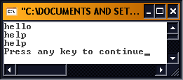
Output

Slide 188
Strings
h | e | l | l | o | \0
This is what array name looks like – four array elements never populated with the string.
Note the ‘\0’ null sentinal value.

Slide 189
Arrays
This program reads in the text that you type, terminating it with a null and stores it in the character array name.
It then prints the character array treating it as a string, i.e. stopping when it hits the first null string.
Notice the use of the "%s" format descriptor in scanf and printf to specify that what is being printed is a string.

Slide 190
Stringing Along
A string is just a character array with the convention that the end of the valid data is marked by a null '\0'.
Now you should be able to see why you can read in a character string using scanf("%s", name) rather than scanf("%s",&name) - name is already a pointer variable.

Slide 191
Strings
You can initialize an array a number of different ways - For example:
int a[5] = {1,2,3,4,5};
declares an integer array and initialises it so that a[0]= 1, a[1] = 2 and so on.
A character array can be initialised in the same way. For example:
char a[5]={'h','e','l','l','o'};

Slide 192
Strings
but a much better way is to write:
char a[6]="hello";
which also automatically stores a null character at the end of the string - hence a[6] and not a[5].
If you really want to be lazy you can use:
char a[] = "hello";
and let the compiler work out how many array elements are needed. Some compilers cannot cope with the idea of initialising a variable that doesn't exist for the entire life of the program.

Slide 193
/***********************************************
Program on output of array output
***********************************************/
#include<stdio.h>
main()
{
int i=3;
double x[8] ={16,12,6,8,2.5,12,14,-54.5};
printf("%d %.1f\n",4,x[4]);
printf("%d %.1f\n",i,x[4]);
printf("%.1f\n",x[i]+1);
printf("%.1f\n",x[1+i]);
printf("%.1f\n\n\n",x[4]*x[6]);
for(i=0; i<=7; i++){
printf("x[%d] = %.1f\n",i,x[i]);
}
}

Slide 194
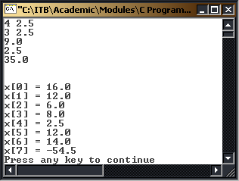
Output

Slide 195
Multiple-Subscripted Arrays
Multiple subscripted arrays
  Tables with rows and columns (m by n array)
  Like matrices: specify row, then column
Column 0
Column 1
Column 2
Column 3
Row 0
a[ 0 ][ 0 ]
a[ 0 ][ 1 ]
a[ 0 ][ 2 ]
a[ 0 ][ 3 ]
Row 1
a[ 1 ][ 0 ]
a[ 1 ][ 1 ]
a[ 1 ][ 2 ]
a[ 1 ][ 3 ]
Row 2
a[ 2 ][ 0 ]
a[ 2 ][ 1 ]
a[ 2 ][ 2 ]
a[ 2 ][ 3 ]
Column subscript
Array name
Row subscript

Slide 196
Multiple-Subscripted Arrays
Initialization
  int b[ 2 ][ 2 ] = { { 1, 2 }, { 3, 4 } };
  Initializers grouped by row in braces
  If not enough, unspecified elements set to zero
    int b[ 2 ][ 2 ] = { { 1 }, { 3, 4 } };
Referencing elements
  Specify row, then column
    printf( "%d", b[ 0 ][ 1 ] );
1 | 2
3 | 4
1 | 0
3 | 4

Slide 197
//2D array example
#include<stdio.h>
main()
{
int i,j;
double b[2][3] = {{1.1, 2, 3.2},{2, 3.6, 4}};
double c[3][5] = {{1, 2.1, 3, 4, 5},{2.8, 3,4, 5.9, 6},{3.6, 4.1, 5.3, 6,7.2}};
printf("MATRIX b:\n");
for(i=0; i<=1; i++){
for(j=0; j<=2; j++){
printf("%.1lf ",b[i][j]);
if(j==2){
printf("\n");
}
}
}

Slide 198
printf("_____________________________\n\n");
printf("MATRIX c:\n");
for(i=0; i<=2; i++){
for(j=0; j<=4; j++){
printf("%.1lf ",c[i][j]);
if(j==4){
printf("\n");
}
}
}
}

Slide 199
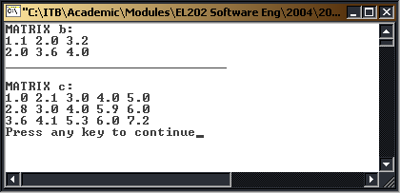
Output

